Slide 1
Data Visualization in R
Aditya Vadrevu

Slide 2
Basic Overview
Used by data scientists and statisticians
Mainly used for developing statistical software and data analysis
Used in many companies alongside Python
KD Nuggets Ranked it #1 overall for Data scientists
First used in ‘93

Slide 3
Why use R
R is very efficient
Can be used across multiple cores in CPU
Can be used on computer clusters
Handles big data very well
R is also very flexible
Packages to suit any purpose
Syntax is very simple and readable

Slide 4
Efficiency
Statically Typed
Easy to read/write
Recursion

Slide 5
Security & Extensibility
Semantically Safe
User defined packages
Can introduce new operators

Slide 6
Data Visualization Models
Histogram
Barchart
Scatterplot
Tree Map
Heat Map
WordClouds

Slide 7
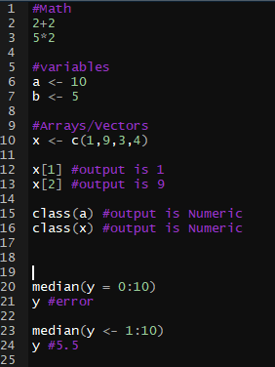
Notes:
Code in R does not need to be compiled

Slide 8
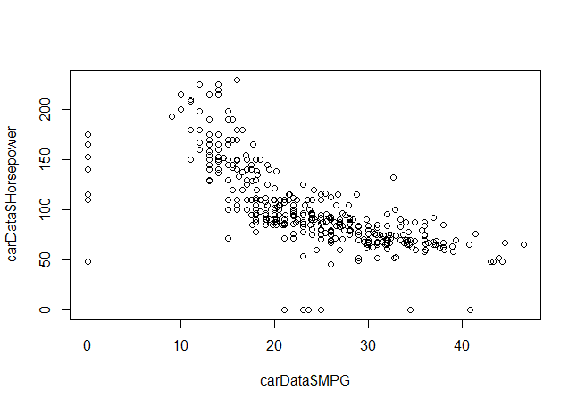
Notes:
This is the basic scatterplot

Slide 9
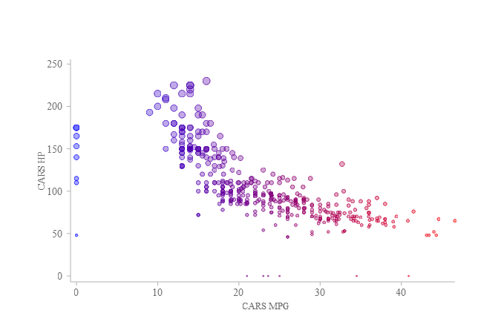
Notes:
This is an interactive scatterplot that show horsepower mpg and the name of the car

